Slide 1

Python

Slide 2

PYTHON
HIGH LEVEL PROGRAMMING LANGUAGE
EASY TO LEARN
INTERRETED LANGUAGE
IT WAS CREATED BY GUIDO VAN ROSSEUM
READABLE SYNTAX SIMILAR TO ENGLISH
SUPPORTS MULTIPLE PROGRAMMING PARADIGMS
WIDELY USED IN WEB DEVELOPMENT,DATA SCIENCE,GAME DEVELOPMENT

Slide 3
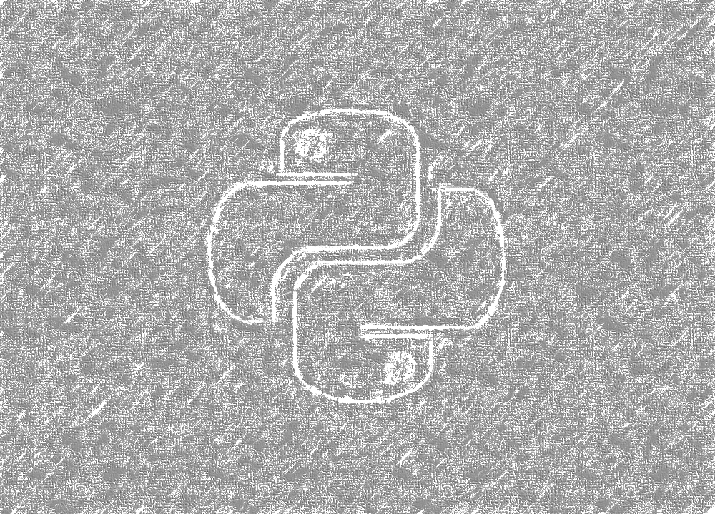
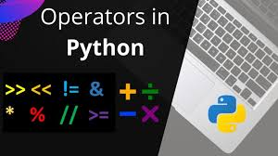
OPERATORS
ARITHMETIC OPERATORS
COMPARISON OPERATORS
LOGICAL OPERATORS
ASSIGNMENT OPERATORS
BITWISE OPERATORS
MEMBERSHIP OPERATORS
IDENTITY OPERATORS

Slide 4
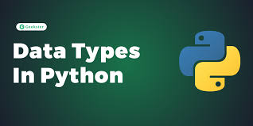
DATA TYPES
LISTS
TUPLES
STRINGS
RANGE
NUMBERS
DICTIONARY

Slide 5
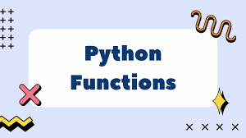
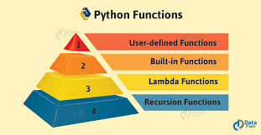
FUNCTIONS
A FUNCTION IS A BLOCK OF CODE THAT ARE DESIGNED TO PERFORM A SPECIFIC TASK . FUNCTION ALLOW YOU TO AVOID REPETITIVE CODE AND MAKE YOUR PROGRAM MORE MODULAR AND READABLE .
YOU DEFINE A FUNCTION IN PYHTON USING THE DEF KEYWORD .
BUILT-IN FUNCTION : PREDEFINED FUNCTIONS LIKE print() , len(), sum() ,etc ..
LAMBDA FUNCTION : THEY ARE OFTEN USED FOR SMALL . THROWAWAY FUNCTIONS ANONYMOUS FUNCTIONS DEFINED USING THE LAMDA KEYWORD .
USER-DEFINED FUNCTION : CUSTOM FUNCTIONS CREATED USING DEF KEYWORD
RECURSIVE FUNCTION : FUNCTIONS THAT CALL THEMSELVES .

Slide 6
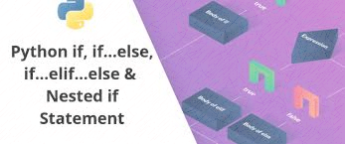
CONDITIONS
IF STATEMENTS
ELIF STATEMENTS (ELSE IF)
ELSE STATEMENTS
NESTED IF STATEMENTS

Slide 7
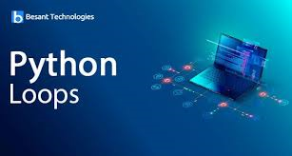
LOOP STATEMENTS
FOR LOOP
WHILE LOOP
DO-WHILE LOOP
BREAK STATEMENT
CONTINUE STATEMENT
PASS STATEMENT

Slide 8
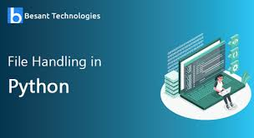
FILE HANDLING
FILE HANDLING IN PYTHON ALLOWS YOU TO INTERACT WITH FILES ON YOUR COMPUTER-READING FROM AND WRITING TO THEM . PYTHON PEOVIDES BUILT-IN FUNCTIONS TO HANDLE FILES . WHICH MAKES FILE MANIPULATION STRAIGHTFORWARD .
OPENING FILE – open()
READING FILE – read()
APPEND FILE – (“a”)
CLOSING FILE – close()

Slide 9
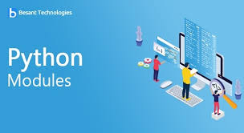
Python modules
PYTHON HAS A LARGE ECOSYSTEM OF EXTERNAL MODULES THAT ARE AVAILABLE THROUGH THE PYTHON PACKAGE INDEX(PYPI) .
YOU CAN INSTALL THESE MODULES USING THE PACKAGE MANAGER PIP .
PIP STANDS FOR “PIP INSTALLER PACKAGES”
EXTERNAL MODULES :
REQUESTS : for making HTTP requests
NUMPY : for numerical computing
PANDAS : for data analysis
MATPLOTLIB : for plotting graphs and data visualization

Slide 10

Sample program
# ADDING TWO NUMBERS
# Taking user input
num1 = int(input("Enter first number: "))
num2 = int(input("Enter second number: "))
# Adding the numbers
result = num1 + num2
# Displaying the result
print("The sum is:", result)
OUTPUT :
Num = 2
Num = 3
The sum is : 5

